Slide 1

SENTIMENT ANALYSIS USING COVID-19 TWEETS
Team 8 Members:
Keerthi Kalla (5E0)
Ram Akhilesh Noone (5H9)
Jakka Venkatesh (518)
Guide Name:
Mr. Jayendra Kumar
Assistant professor, cse

Slide 2
CONTENT
Abstract
Introduction
Existing Approaches
Drawbacks
Motivation
Objectives
Methodology used
Tools and Technologies used
Conclusion
References

Slide 3
ABSTRACT
Sentiment Analysis is a process of extracting opinions that have different polarities. By polarities, we mean positive, negative or neutral. It is also known as opinion mining and polarity detection.
In social media, information is present in large amount. Extracting information from social media gives us several usage in various fields. Twitter is one of the social media which allows the user post tweets of limited number of characters and share the tweet to their followers. Twitter also allows application developers to access the tweets for their purpose.
The aim of this project is to build a sentiment analysis model which will allow us to categorize words based on their sentiments, that is whether they are positive, negative and also the magnitude of it. In the implemented system, tweets are collected and sentiment analysis is performed on them. Based on the results of sentimental analysis a few suggestions can be provided to the user.

Slide 4
INTRODUCTION
Sentiment analysis nowadays can be considered as one of the most popular research topics in the field of natural language processing. The uses of sentiment analysis are covered by some interesting scientific and commercial areas, such as opinion mining, recommender systems, and event detection.
Nowadays the social media platforms such as Twitter, Facebook and YouTube, are a great source of information known as social data. The events occurring in normal daily life are discussed on social media and any individuals are free to discuss and express their opinion about these events. Coronavirus known as COVID-19 which began to appear at the end of last year in Wuhan, China has been one of the most discussed and one of the most spreading diseases worldwide.
Analyzing and sharing insights from these data on the social media platforms could help health staff and government organizations to get benefit from those data, and understand from people’s reaction and express their feelings

Slide 5
EXISTING APPROACHES
Sentiment Analysis can be employed on Twitter posts by means of following techniques:
Lexical analysis
Machine learning based analysis
Hybrid/Combined analysis
DRAWBACKS
Major drawback of twitter sentiment analysis is its problem with recognizing things like sarcasm and irony, negations, jokes, and exaggerations - the sorts of things a person would have little trouble identifying and failing to recognize these can skew the results.

Slide 6
MOTIVATION
The Corona Virus endangers our physical health indeed, but alongside, social distancing also poses a threat to our emotional stability. Thus, it is crucial to understand public sentiments under COVID-19.
The motivation behind this work has been to portray the fact that how irrationally people are behaving in the grim times of a pandemic. This particular pandemic seems to have claimed millions of lives and is leading the world to an utter recession in terms of economy. It would have been easier for the victims at this time to have gathered some structured information from social media. This call in for a strict quality check of the tweets to ensure that meaningful content are shared in these most used social networking sites.

Slide 7
OBJECTIVES
The aim is to find the opinionative data and classify it according to its polarity, i.e. positive, negative or neutral feedback.
Before performing sentiment examination, the information is exposed to different pre-processing procedures which finally give the desired optimized output.
This allows us to get to know about the public’s mood or opinion about a particular topic.
This summarization helps the concerned organization or public to improve their product or service based on the feedback received.

Slide 8
METHODOLOGY USED
We will carry out sentiment analysis with R in this project. In order to build our project on sentiment analysis, we will make use of the tidytext package that comprises of sentiment lexicons that are present in the dataset of ‘sentiments’.
We will make use of three general purpose lexicons like – AFINN, bing, loughran.
The COVID-19 Tweets dataset will provide us with the textual data and Tidytext will allow us to perform efficient text analysis on our data. We will convert the text into a tidy format using unnest_tokens() function.
In the next step, we will use spread() function to segregate our data into separate columns of positive and negative sentiments. We will then use the mutate() function to calculate the total sentiment, that is, the difference between positive and negative sentiment.
Lastly, we will perform visualization of our sentiment score. We will plot the scores along the axis that is labeled with both positive as well as negative words. We will use ggplot() function to visualize our data based on their scores.

Slide 9
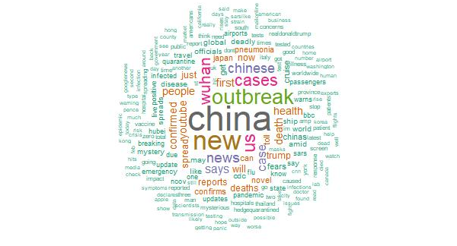
TOOLS & TECHNOLOGIES USED
R Programming
R – Studio
Data Mining
Lexical Analysis
Data Visualization

Slide 10
CONCLUSION
The present study applied sentiment analysis on twitter data related to worldwide COVID-19 outbreaks. The data has been collected during one of the most spread weeks of coronavirus by using Twitter API. From this study we can say that people's reactions vary day to day from posting their feelings on social media specifically Twitter.
Lexical approach is a ready-to-go and doesn’t require any prior information or training. We are able to delineate the data through various visualizations after we perform data wrangling on our data. We make use of lexical analyzer – ‘bing’ in this instance of our project. Furthermore, we also represent the sentiment score through a plot and also a visual report of wordcloud will be made.

Slide 11
REFERENCES
Barkur, Gopalkrishna, and Giridhar B. Kamath Vibha. "Sentiment analysis of nationwide lockdown due to COVID 19 outbreak: Evidence from India." Asian journal of psychiatry (2020).
Mansoor, Muvazima, Kirthika Gurumurthy, and V. R. Prasad. "Global Sentiment Analysis Of COVID-19 Tweets Over Time." arXiv preprint arXiv:2010.14234 (2020).

Slide 12
THANK YOU

